Slide 1

WFU Laundry View
Karim Soliman, Kevin Davis, Daniel Conde

Slide 2
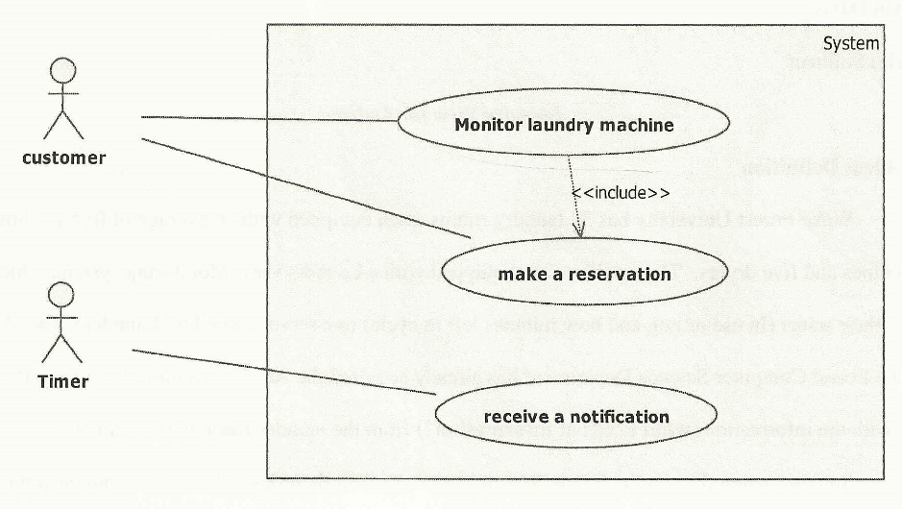
Use Case Diagram

Slide 3
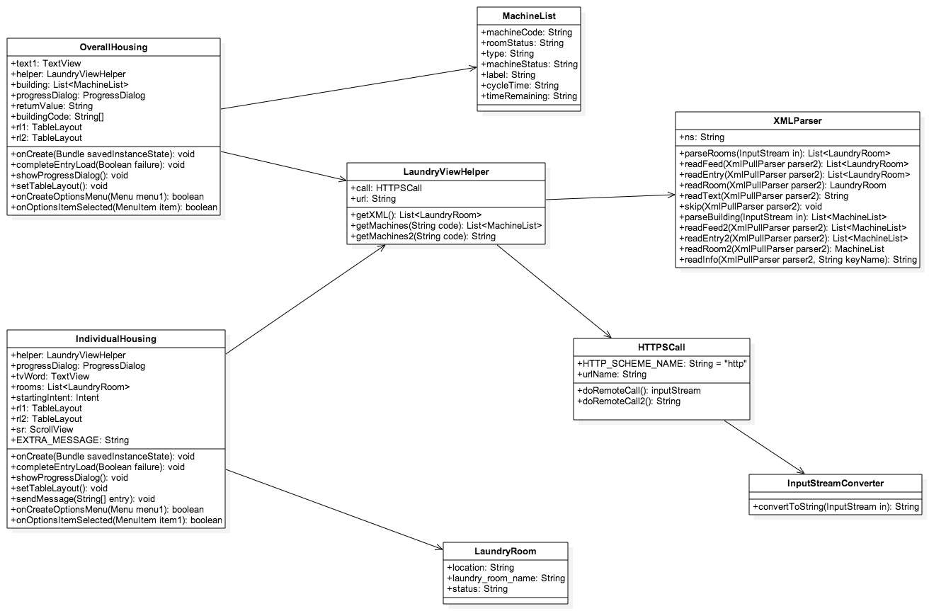
UML Diagram

Slide 4
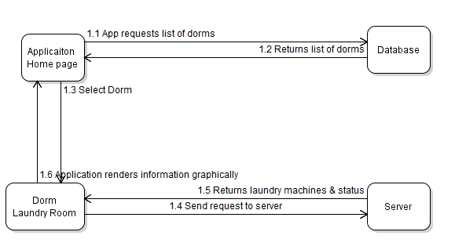
Sequence Diagram

Slide 5
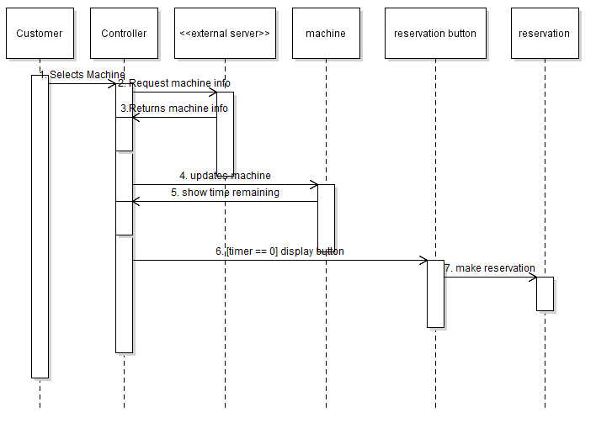
Sequence Diagram Make Reservation

Slide 6
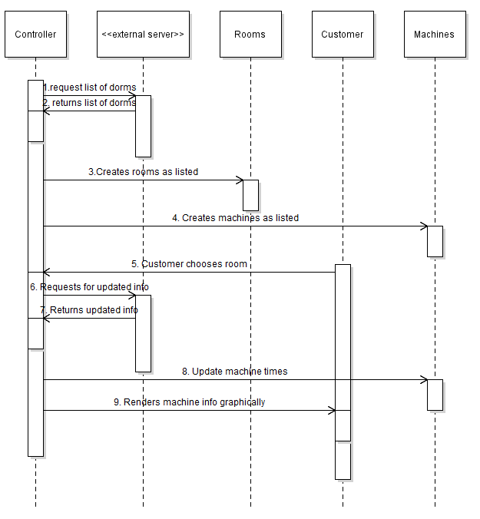
Sequence Diagram Monitor Laundry Machine

Slide 7
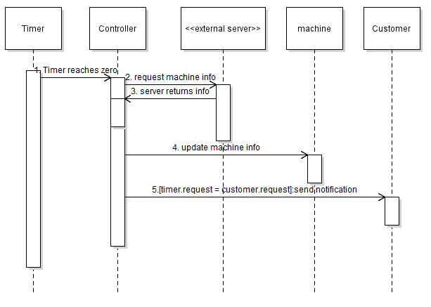
Sequence Diagram Receive Notification

Slide 8
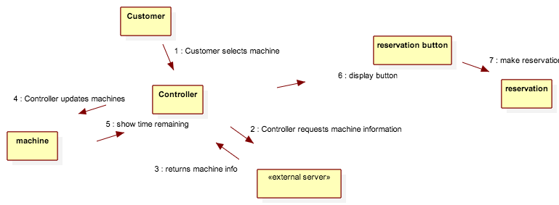
Communication Diagram Make Reservation

Slide 9
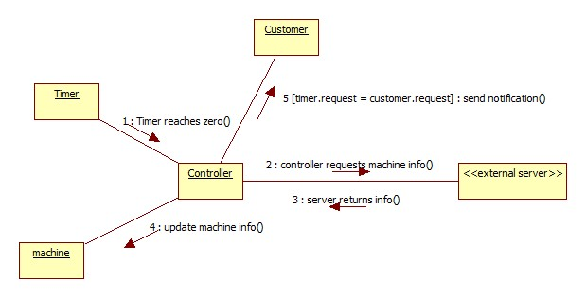
Communication Diagram Receive Notification

Slide 10
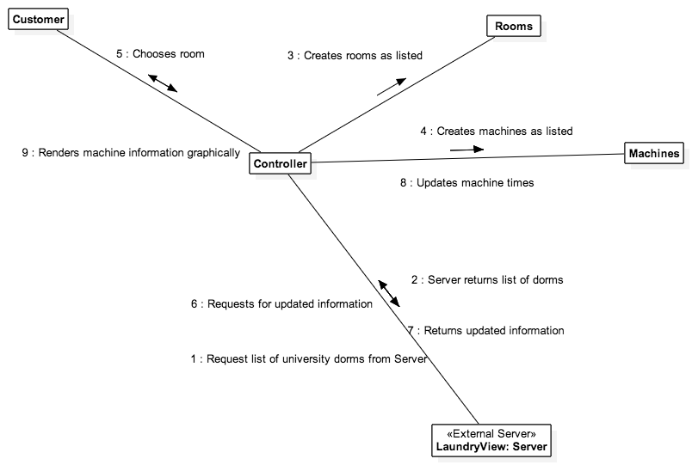
Communication Diagram Request View Machine

Slide 11
DEMO TIME!

